Slide 1
TOPIC 2a Data Structures: HEAPS

Slide 2
Data STRUCTURES
Data structures are used for organizing data in memory.
Algorithms and Data structure go hand in hand
Without appropriate data structures algorithms would be slow
Without algorithms data cannot be manipulated
Data Structures defined by their operations
For dynamic sets: Insert, Delete, Search, Minimum, Maximum, Predecessor (in a sorted list), Successor (in a sorted list)
More complicated operations for complex data types
Abstract Data Type (ADT)
Operations that can be performed on the data structure and the complexities of the operations
Example: Heaps
Data Structure
The implementation of the ADT, depends on the language, the platform, etc.
Example: Heaps implemented as arrays

Slide 3
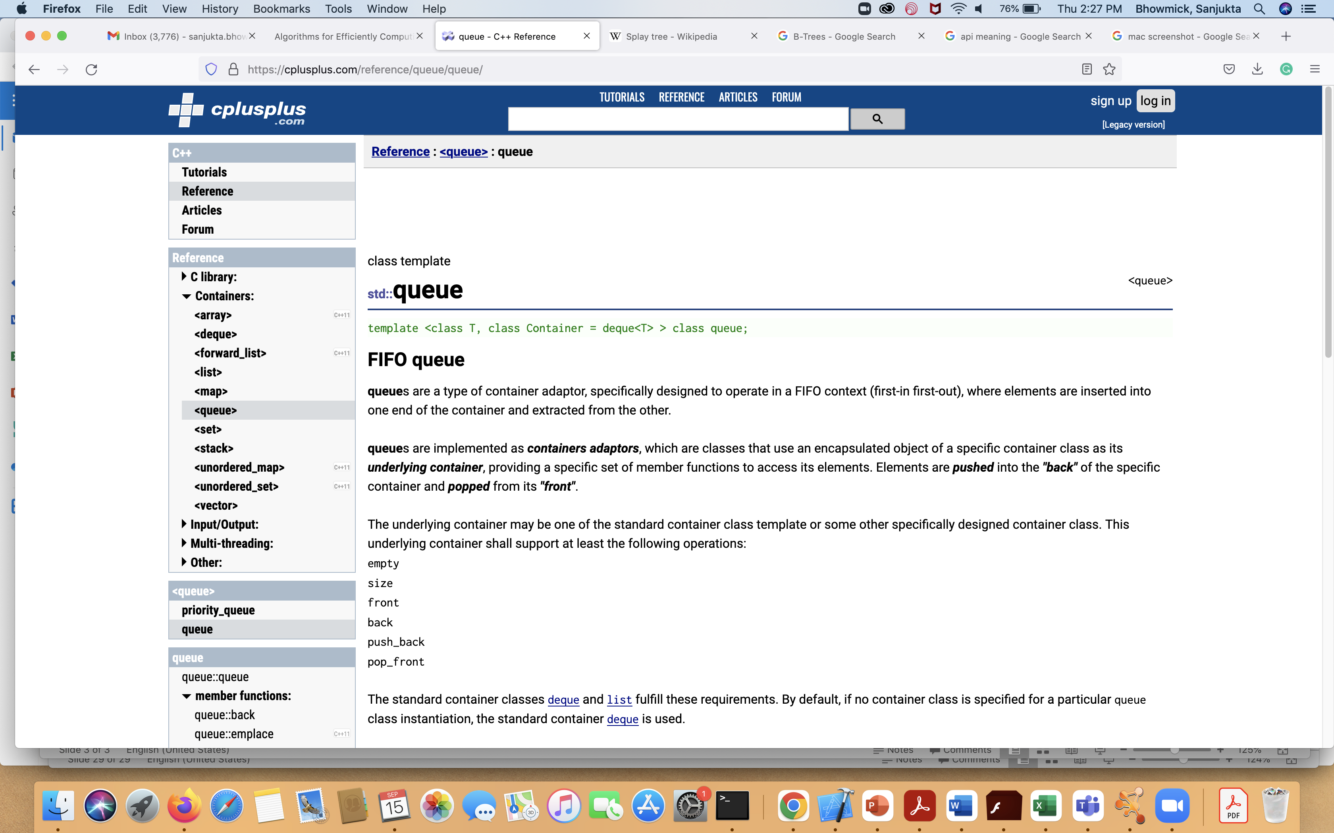
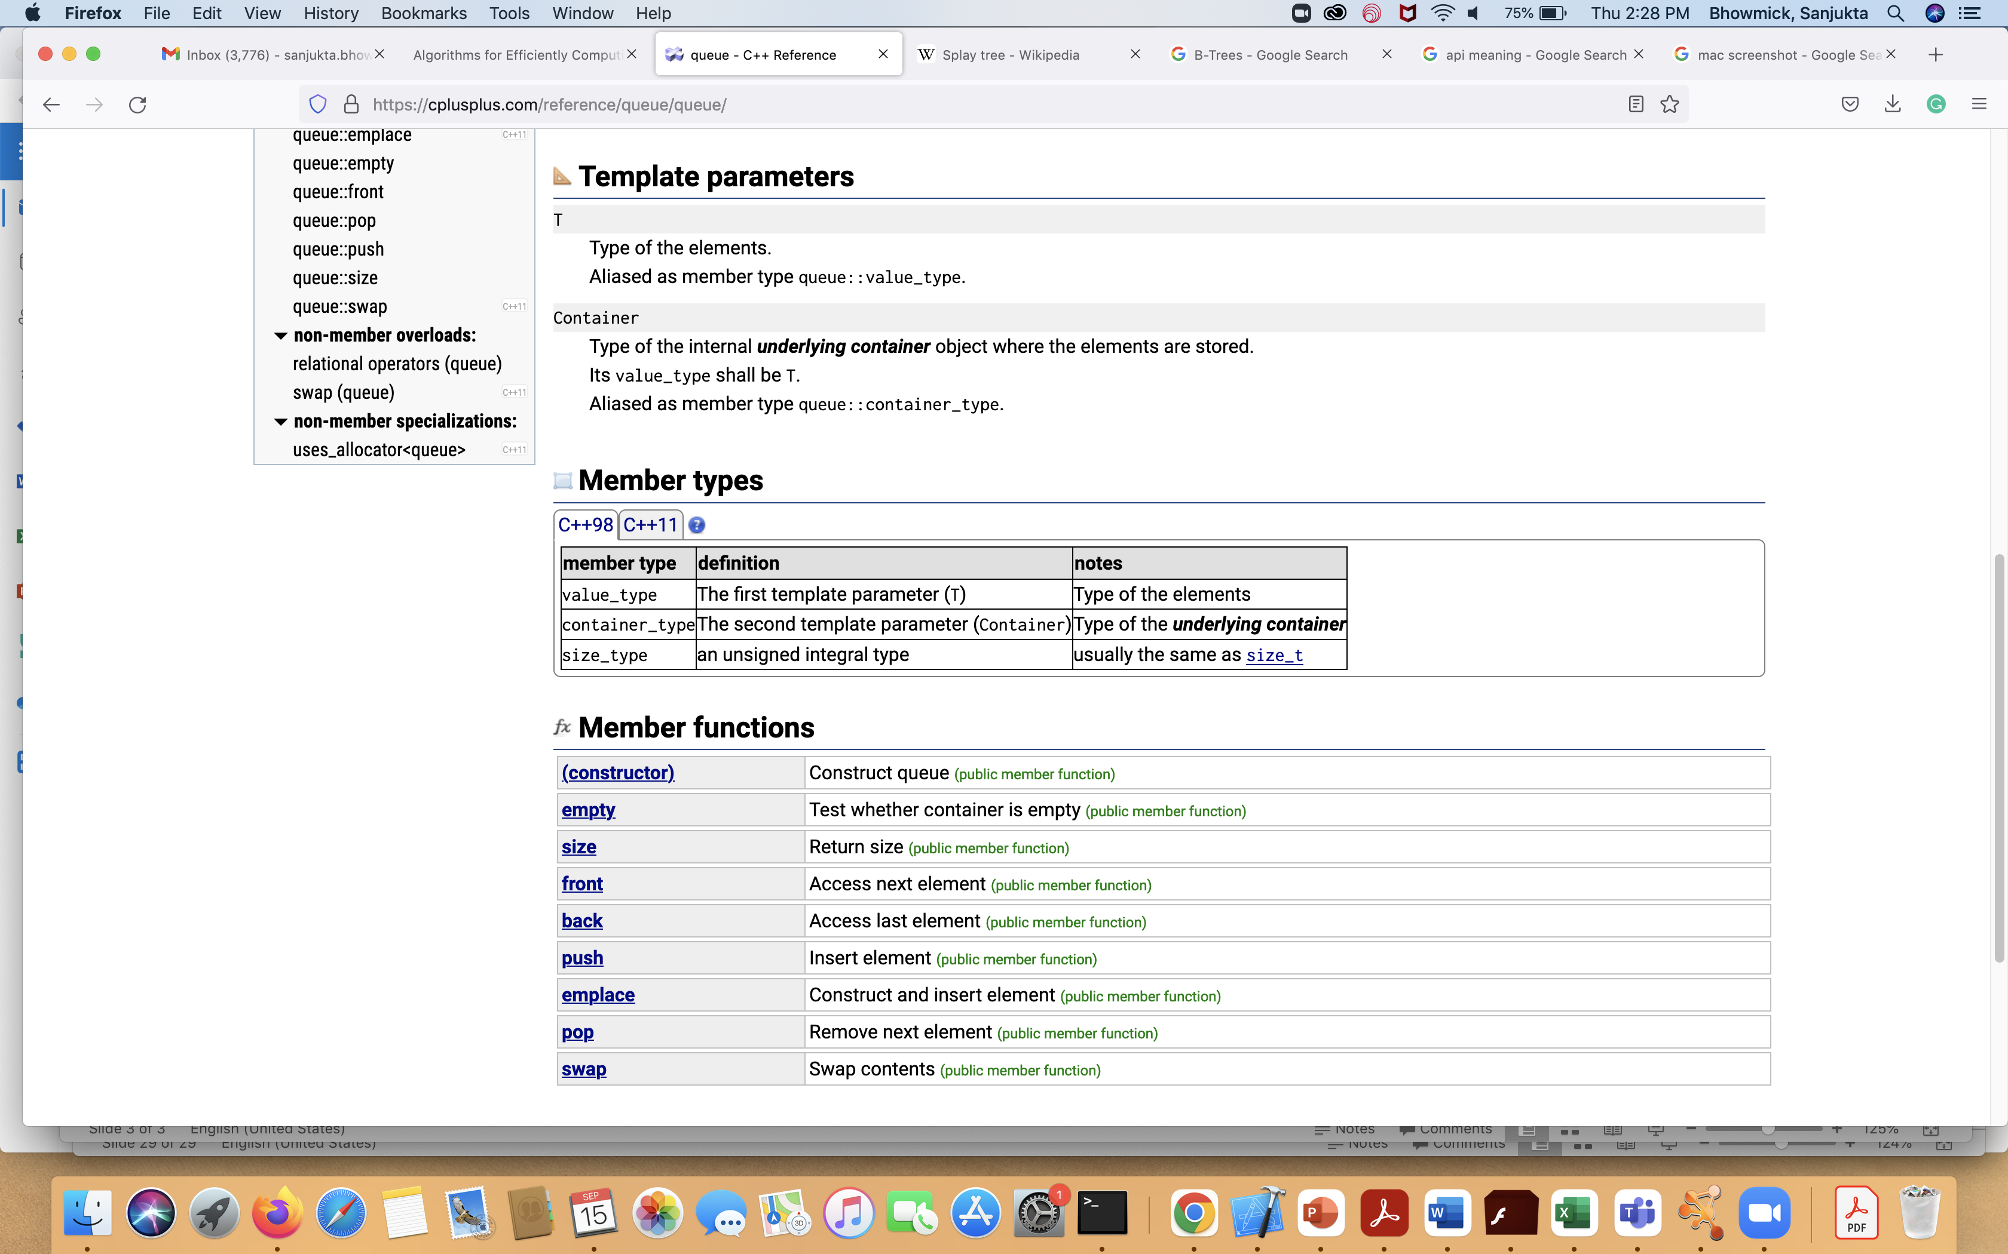
Describing A DATA STRUCTURE
API (Application Programming Interface):
Functions provided by the data structure and their complexities
Invariants
Properties that hold true during the lifetime of the data structure
Data Model
How is the data stored; list, array, etc.
Algorithms
Algorithms to support the API functions

Slide 4
Priority Queues
Given a dynamic data set, enable access to element with highest priority
Queue: First in First out (Priority: highest time stamp)
Stack: Last in First out (Priority: lowest time stamp)
Used in scheduling, shortest paths, efficient routing, etc.
More general: heaps
Max heap: Element with highest value
Min heap: Element with lowest value
Operations
Top: remove element with highest priority from top
Peek: check what is the element with the highest priority
Insert: insert an element, along with its priority
Delete: remove an element
Update: update the priority of an element

Slide 5
Binary Heap
32
21
16
20
13
9
15
Invariant Properties
Is a complete binary tree
Every level except possibly the last is filled and the leaves are as far left as possible (fill from left to right)
What is the benefit ?
For a maxheap: every node i other than the root, A[parent(i)] > A[i]
Parents are greater than children
Reverse if minheap
What does that imply about the root ?
Not complete binary tree
10
3
32
19
16
20
13
9
15
10
A[parent(i)] not more than A[i]
32
21
16
20
31
9
15
10
12
3
Binary Heap

Slide 6
Binary heap
For any element in array position i, the left child is in position 2i, the right child is in the cell after the left child (2i+1), and the parent is in position ⎣i/2⎦
The operations required to traverse the tree are extremely simple and very fast on most computers.
32
21
16
32 | 21 | 16 | 20 | 31 | 9 | 15 | 10 | 12 | 3
1 | 2 | 3 | 4 | 5 | 6 | 7 | 8 | 9 | 10
20
31
9
15
10
12
3

Slide 7
Updating—Increase KEY
Complexity: O(logn)

Slide 8
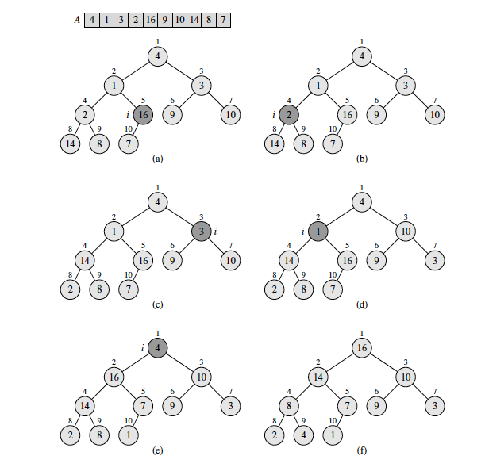
Build Heap
Max Heap
Fill the heap in order the numbers appear in the array A
For i=length[A]/2 to 1
Start with the rightmost nonleaf node to root
Percolate down until heap property is achieved
A[parent[i]]>A[i]

Slide 9
Complexity of building heap
To build the heap, we have to heapify n elements
Each element takes O(log n) time = height of the tree
What is the total time to build the heap
n*O(logn)=O(nlogn)
However, by creating a max heap we can only know the element with the maximum value
We could have had the information in O(n) time by just going through the array
Why is build heap more expensive ?

Slide 10

Tighter Build-Heap Time
Each node does not traverse any more than its height.
There are at most ceil(n/2^{h+1}) nodes at height h.
Therefore total number of traversals

Slide 11



Tighter Build-Heap Time
Geometric Series
If x<1 and n tends to inf
Taking the derivative on each side
Set x=1/2 to compute bound on build heap to be O(n)

Slide 12
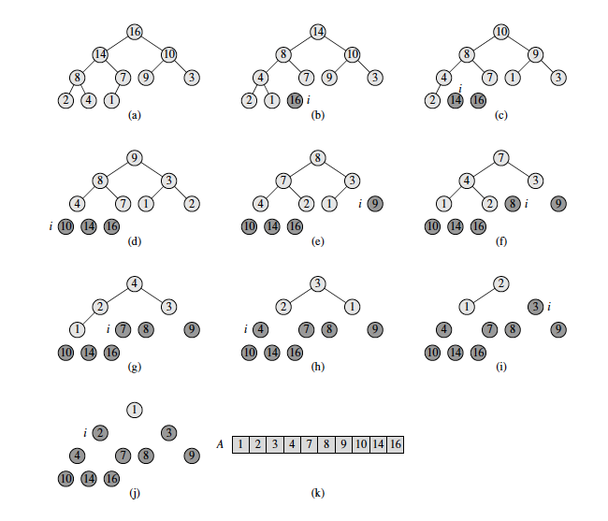
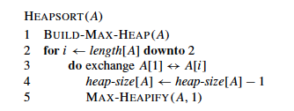
HeapSort
Replace element to be deleted by the last in array.
Delete the last element
Update heap to maintain heap property
Deleting elements takes O(logn)
Heapsort=Deleting n elements
O(log(n))+ log(n-1) +… 1) =O(logn!)=O(nlogn)

Slide 13
Complexities of HEAp OPERATIONS
Top : O(1)
Peak: O(1)
Insert: O(logh), worst case O(logn)
Delete: O(logh), worst case O(logn)
Update: O(log h), worst case O(logn)
How do we combine two heaps ?
Can we do Insert and Update in O(1) ?

Slide 14
MERGING TWO HEAPS
20
40
30
60
50
110
100
150
90
80
70
120
140
130
If we concatenate the arrays and recreate the heap O(m+n)
If smaller heap has n elements, and we just insert these elements, then total cost is O(n)
Can we do better ?

Slide 15
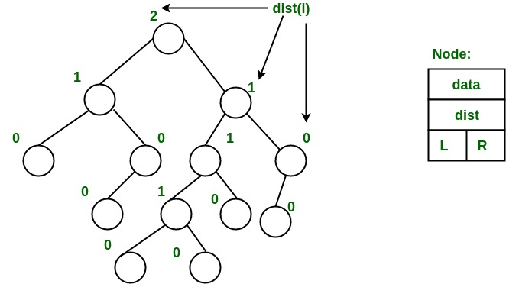
Leftist Heap
A leftist heap is a binary heap where
Element of highest priority (max/min) is at top
Left(S_value)>= Right(S_value)
S_value=distance to leaf
S_value of leaf =0
S_value of node with one child=0
Image from https://www.geeksforgeeks.org/leftist-tree-leftist-heap/

Slide 16
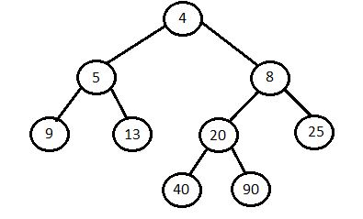
Building Leftist Heap
Insert new node as rightmost leaf
Check if S_value criteria is maintained
Otherwise swap the left and right subtrees to maintain the criteria
https://www.cs.usfca.edu/~galles/visualization/LeftistHeap.html
Image from https://iq.opengenus.org/leftist-heap/

Slide 17
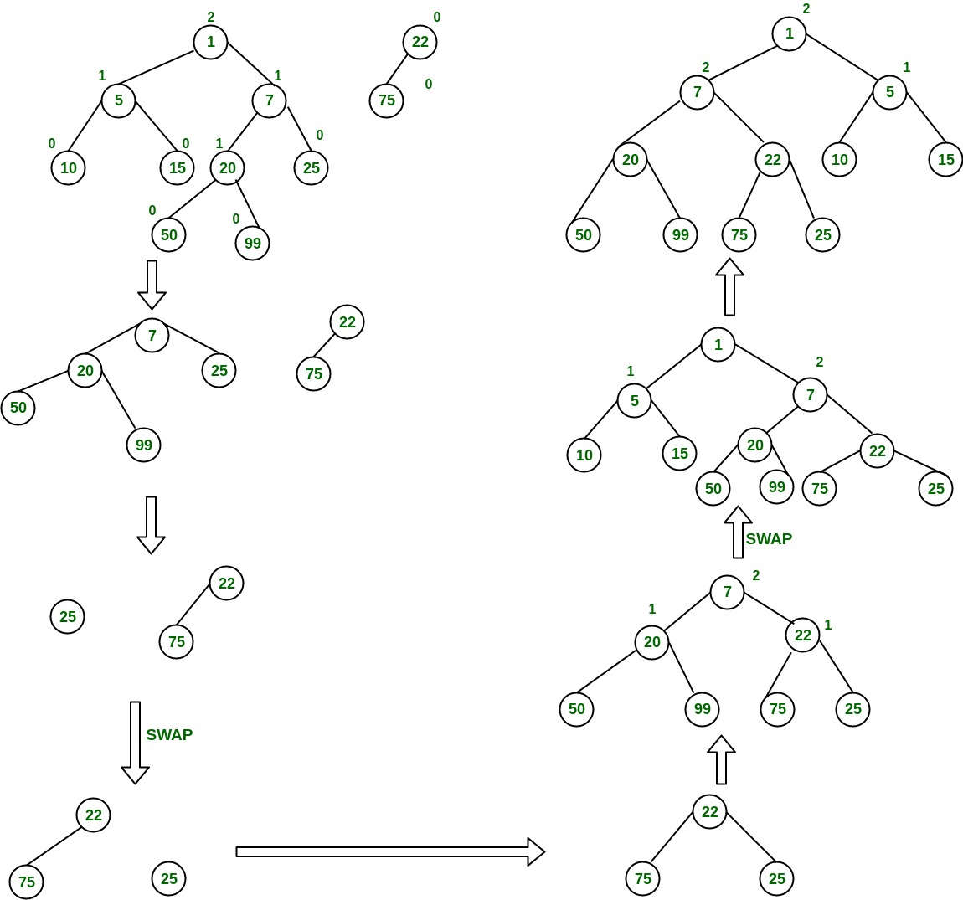
Merging Leftist Heaps
Merge(H1, H2)
If H1 or H2 contains one node, insert as usual
If root(H1)<root(H2)
right_subtree(H1)=new_H2
H2=new_H1
Else
right_subtree(H2)=new_H2
H1=new_H1
Swap to maintain S_value criteria
as needed
Merge(new_H1, new_H2)
https://www.geeksforgeeks.org/leftist-tree-leftist-heap/

Slide 18
Deletion
Remove Root
This will create two trees
Merge them
Complexity of Insertion (one element), Deletion (one element) and Merging (smallest tree has n elements) are all O(logn)
Why do we get O(logn), given that the tree is not balanced ?

Slide 19
Property of Leftist HEAp
Given a heap with n elements, the shortest path from root to a leaf is O(logn)
Since Right(S_value)<=Left(S_value); therefore one of the shortest path will to the rightmost leaf
Let the Right(S_value) of root be x
That means there are at least x nodes from root to leaf.
Since nodes without two children have S_value 0, therefore all nodes with S_value >1 in the path will have two children.
Thus there are at least 2^{x}-1 nodes
2^{x}-1 <=n (n is total number of nodes)
x<=O(log(n))
Since we are prioritizing new insertions in the right subtree, therefore complexity if O(logn)

Slide 20
Binomial Queues
Binomial queues support all three operations (insertion, deleteMin, and merge) in O(log N) worst-case time per operation, but insertions take constant time on average.

Slide 21
Binomial Queue Structure
Binomial queue is not a heap-ordered tree but rather a collection of heap-ordered trees, known as a forest.
Each of the heap-ordered trees is of a constrained form known as a binomial tree.

Slide 22
How to construct a binomial tree?
A binomial tree B₀ of height 0 is a one-node tree;
A binomial tree, B_{k}, of height k is formed by attaching a binomial tree, B_{k-1}, to the root of another binomial tree, B_{k-1}.

Slide 23
Binomial Trees B₀, B₁, B₂, …
B₀
B₁
B₂
B₃
B₄

Slide 24
Properties
A binomial tree, B_{k}, consists of a root with children B₀, B₁, …, B_{k-1}.
The height of a binomial tree, B_{k}, is k.
Binomial trees of height k have exactly 2^{k} nodes.
The number of nodes at depth d is the binomial coefficient (root has depth 0 and height k)
= k! / ((k-d)!·d!).

Slide 25
Priority Queue using binomial trees
Impose heap order on the binomial trees
Allow at most one binomial tree of any height
Then, we can uniquely represent a priority queue of any size by a collection of binomial trees.
HOW ?

Slide 26
A Priority Queue of size 13
B₃
B₂
B₀
13 = 1101

Slide 27
A Priority Queue of size 6
B₂
B₁
12
16
21
24
18
65
6 = 110

Slide 28
Binomial Queue Operations
Find the minimum element: O(log N)
The minimum element can be found by scanning the roots of all the trees. Since there are at most log N different trees, the minimum can be found in O(log N) time.
We can maintain knowledge of the minimum and perform the operation in O(1) time.

Slide 29
Merging two binomial queues
H₁:
H₂:
13
14
23
16
12
51
24
18
21
24
26
B₀
B₁
B₂
65
B₁
B₂
65
H₃:
13
23
12
51
24
21
24
14
65
65
26
16
B₀
B₀
B₂
B₃
18

Slide 30
Exercise: Merging two binomial queues
H₁:
13
23
12
51
24
21
24
14
65
65
26
16
18
H₂:
4
15
2
11
29
18
55

Slide 31
Complexity on merge
Merging two binomial trees takes constant time.
There are O(log N) binomial trees.
So merge two binomial queues take O(log N) time in the worst case.
To make this operation efficient, we need to keep the trees in the binomial queue sorted by height.

Slide 32
Representation of binomial queue
13
23
12
51
24
21
24
14
65
65
26
16
18

Slide 33
Insertion
Insertion is just a special case of merging: create a one-node tree and perform a merge.
Worst case: O(log N)
Averagely: O(1)
Performing N inserts on an initially empty binomial queue will take O(N) worst-case time

Slide 34
DeleteMin
Find the binomial tree with the smallest root. Let this tree be B_{k}, and let the original binomial queue be H.
Remove the binomial tree B_{k} from H, and form a new binomial queue H’.
Remove the root of B_{k}, create binomial trees B₀, B₁, …, B_{k-1}, and form another new binomial queue H’’.
Merge H’ and H’’.

Slide 35
DeleteMin Operation
H₃:
13
23
12
51
24
21
24
14
65
65
26
16
13
23
18
H’:
51
24
Merge H’ and H’’.
65
H’’:
21
24
14
65
26
16
18

Slide 36
Complexity on deleteMin
It takes O(log N) time to find the tree containing the minimum element.
Constant time to create the queues H’ and H’’.
Merging these two queues takes O(log N) time.
Entirely O(log N) time

Slide 37
Summary
Binary Heaps: Find minimum is constant; Insertion, Delete in O(logN); Merge is O(n+m)
Leftist heaps: Merge is O(logn). Not balanced
Binomial Heap: Insertion is constant on average. A forest of multiple binomial trees
Other types of heaps:
D-way heaps, Fibonacci heaps, etc.

